Slide 1
Great plains regional medical center
2025 CHNA

Slide 2
overview
In the spring of 2025, Great Plains Regional Medical Center (GPRMC) conducted a Community Health Needs Assessment (CHNA) for the residents of Beckham County, Oklahoma.
The CHNA was conducted with assistance from Eide Bailly LLP, an accounting and consulting firm specializing in financial, operational, and strategic consulting with healthcare organizations.
A CHNA is a tool used to help communities assess their strengths as well as their opportunities when it comes to the health of the community. It is also the foundation for improving and promoting the health of the community. The process helps to identify factors that affect a community’s health and determines the availability of resources within the community to adequately address these factors and any additional health needs.

Slide 3
overview
The CHNA process fulfills the requirements set forth by Internal Revenue Code 501(r)(3), a statute established within the Patient Protection and Affordable Care Act, which requires not-for-profit hospitals to conduct a CHNA every three years. This report includes qualitative and quantitative information from local, state, and federal sources. In addition, input was received from persons that represented a broad range of interests in the community, persons with public health knowledge and expertise, and persons representing medically underserved and vulnerable populations.
Input received from the public on our 2022 CHNA would have been considered in the process, but no feedback was received. GPRMC will create an implementation plan to clarify how it and other community resources will address the needs identified during the CHNA process.

Slide 4
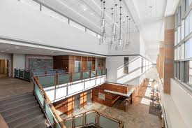
Organization overview
Great Plains Regional Medical Center features a 62-bed short term acute hospital in Elk City, Oklahoma and is accredited by the Joint Commission. GPRMC provides a full continuum of care from acute to intensive care levels.
As a public-not-for-profit healthcare system, Western Oklahomans depend on GPRMC for the care and treatment through14,000 emergency room visits, the delivery of over 300 babies, and over 3,500 surgical procedures each year.
GPRMC is unique in its history. Founded and brought into existence by a crusading physician and the people of Western Oklahoma against all odds, GPRMC is still pushing boundaries by providing comprehensive, cost-effective, high-quality healthcare to our communities.

Slide 5
Organization overview
Great Plains Regional Medical Center provides the following services:
Behavioral Health
Cancer Care
Cardiology
Dermatology
Emergency Care
ENT
Family Medicine
Foot
Home Health
Hospital Care
Imaging & Radiology
Inpatient Rehab
Lab Services
Nephrology
Orthopedics
Pediatrics
Rehabilitation and Physical Therapy
Sleep Medicine
Surgical Services
Urology
Women’s Health

Slide 6
Organization overview
Great Plains Regional Medical Center and its 430 employees endeavor to perform with integrity, compassion, and fairness; continuing to earn the respect of the communities we serve, while nurturing our reputation as a cherished resource and source of pride for all.
Mission: to distinguish itself as the leader in providing comprehensive, cost-effective and high-quality healthcare.

Slide 7
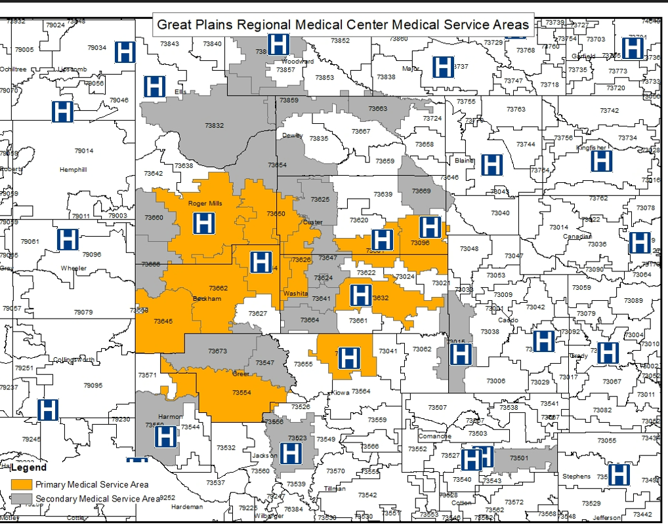
Community served
For this needs assessment, “community” and the service area is defined as the residents of Beckham County, Oklahoma noted in the map. The primary medical service areas are indicated in yellow, with the secondary service areas indicated in gray. All residents of this region are considered members of the community, including low-income, medically underserved, and all races and ethnicities, regardless of ability to pay and/or whether they are eligible for financial assistance.
The primary service area zip codes include Elk City, Sayre, Erick, Hammon, Cheyenne, Cordell, Canute, Magnum, Sentinel, and Clinton. With the secondary service area comprised of Burns, Flat, Carter, Weatherford, Sweetwater, Reydon, Arnett, Lone Wolf, Durham, Butler, Leedey, Foss, Dill City, Hobart, Granite, Hollis, and Altus.
The primary and secondary service areas were determined utilizing GPRMC discharge data by zip code.
SOURCE: OSU Center for Rural Health

Slide 8
Community served – population growth/decline
Population of Great Plains Regional Medical Center
Primary Medical Service Area
 |  | 2000 | 2010 | 2020 | % Change | % Change
Zip Code |  | Population | Population | Population | 2000-2010 | 2010-2020
73644 | Elk City | 12,375 | 14,147 | 14,198 | 14.3% | 0.4%
73662 | Sayre | 5,578 | 6,093 | 6,385 | 9.2% | 4.8%
73645 | Erick | 1,487 | 1,538 | 1,358 | 3.4% | -11.7%
73650 | Hammon | 944 | 1,020 | 1,008 | 8.1% | -1.2%
73628 | Cheyenne | 1,556 | 1,583 | 1,530 | 1.7% | -3.3%
73632 | Cordell | 3,568 | 3,433 | 3,354 | -3.8% | -2.3%
73626 | Canute | 989 | 1,136 | 1,085 | 14.9% | -4.5%
73096 | Weatherford | 12,092 | 13,037 | 14,520 | 7.8% | 11.4%
73554 | Mangum | 3,537 | 3,614 | 3,371 | 2.2% | -6.7%
73651 | Hobart | 4,447 | 4,268 | 3,853 | -4.0% | -9.7%
73601 | Clinton | 9,977 | 10,299 | 9,756 | 3.2% | -5.3%
Total |  | 56,550 | 60,168 | 60,418 | 6.4% | 0.4%
From 2010 to 2020, the Primary Medical Service area population numbers remained relatively flat, seeing an average 0.4% increase.
Eight of the eleven zip codes saw a decline in population, with Erick seeing the largest decrease at -11.7% followed by Hobart at -9.7%.
Weatherford, conversely, saw the largest growth increase, at 11.4%.
SOURCE: Population data from the U.S. Bureau of Census, Decennial Census 2000, 2010 and 2020 (March 2025)

Slide 9
Community served - population growth/decline
Population of Great Plains Regional Medical Center
Secondary Medical Service Area
 |  | 2000 | 2010 | 2020 | % Change | % Change
Zip Code |  | Population | Population | Population | 2000-2010 | 2010-2020
73624 | Burns Flat | 1,852 | 2,142 | 1,960 | 15.7% | -8.5%
73801 | Woodward | 14343 | 15228 | 15671 | 6.2% | 2.9%
73666 | Sweetwater | 94 | 180 | 344 | 91.5% | 91.1%
73660 | Reydon | 457 | 430 | 373 | -5.9% | -13.3%
73832 | Arnett | 969 | 929 | 897 | -4.1% | -3.4%
73625 | Butler | 578 | 554 | 431 | -4.2% | -22.2%
73654 | Leedey | 921 | 866 | 754 | -6.0% | -12.9%
73647 | Foss | 627 | 519 | 598 | -17.2% | 15.2%
73641 | Dill City | 801 | 762 | 671 | -4.9% | -11.9%
73547 | Granite | 2,211 | 2,319 | 1,843 | 4.9% | -20.5%
73550 | Hollis | 2,833 | 2,512 | 2,149 | -11.3% | -14.5%
73664 | Sentinel | 1,067 | 1,184 | 981 | 11.0% | -17.1%
73673 | Willow | 315 | 319 | 302 | 1.3% | -5.3%
73663 | Seiling | 1,333 | 1,332 | 1,282 | -0.1% | -3.8%
73015 | Carnegie | 3,190 | 2,877 | 2,282 | -9.8% | -20.7%
73501 | Lawton | 22,201 | 20,935 | 19,158 | -5.7% | -8.5%
73669 | Thomas | 1,622 | 1,675 | 1,557 | 3.3% | -7.0%
73859 | Vici | 1,312 | 1,459 | 1,369 | 11.2% | -6.2%
73521 | Altus | 23,076 | 21,636 | 20,209 | -6.2% | -6.6%
Total |  | 79,802 | 77,858 | 72,831 | -2.4% | -6.5%
From 2010 to 2020, the Secondary Medical Service area population numbers declined by an average of -6.5%.
Only three of the nineteen zip codes saw growth over the same period, with Sweetwater seeing a 91% growth, followed by Foss at 15.2%, and Woodward at 2.9%.
Butler saw the largest decline in population at -22.2%, followed by Carnegie at -20.7% and Granite at -20.5%.
SOURCE: Population data from the U.S. Bureau of Census, Decennial Census 2000, 2010 and 2020 (March 2025)

Slide 10
Community served - race
Percent of Total Population by Race and Ethnicity for Great Plains Regional Medical Center Medical Service Areas, Beckham County and Oklahoma
 | Primary Medical Service Area | Secondary Medical Service Area | Beckham County | Oklahoma
Race/Ethnic Groups
2010 Census
White | 81.6% | 72.8% | 85.0% | 72.2%
Black | 3.5% | 9.6% | 4.0% | 7.4%
Native American ¹ | 4.5% | 4.7% | 2.8% | 8.6%
Other ² | 6.8% | 8.3% | 5.4% | 5.9%
Two or more Races ³ | 3.6% | 4.6% | 2.8% | 5.9%
Hispanic Origin ⁴ | 12.5% | 14.4% | 11.8% | 8.9%
Total Population | 60,168 | 77,858 | 22,119 | 3,751,351
2020 Census
White | 74.7% | 67.3% | 78.2% | 63.5%
Black | 3.9% | 8.8% | 5.1% | 7.3%
Native American ¹ | 5.1% | 4.6% | 3.8% | 8.4%
Other ² | 6.5% | 8.1% | 5.3% | 7.9%
Two or more Races ³ | 9.9% | 11.2% | 7.5% | 12.8%
Hispanic Origin ⁴ | 15.3% | 17.4% | 12.0% | 11.9%
Total Population | 60,418 | 72,831 | 22,410 | 3,959,353
From 2010 to 2020, the fastest growing race group across the primary medical service area, the secondary medical service area, Beckham County, and the state of Oklahoma are residents that reported two or more races.
In the primary medical service area, as well as in Beckham County and the state of Oklahoma, white residents experienced the largest population decline. In contrast, the secondary medical service area saw the greatest decline among Black residents.
SOURCE: U.S. Census Bureau, Decennial Census data for 2010 and 2020 (www.census.gov [March 2025]).
¹ Native American includes American Indians and Alaska Natives.
² Other is defined as Asian Americans, Native Hawaiians, Pacific Islanders and all others.
³ Two or more races indicate a person is included in more than one race group.
⁴ Hispanic population is not a race group but rather a description of ethnic origin; Hispanics are
included in the five race groups.

Slide 11
Community served - age
Percent of Total Population by Age Group for Great Plains Regional Medical Center Medical Service Areas, Beckham County and Oklahoma
 | Primary Medical Service Area | Secondary Medical Service Area | Beckham County | Oklahoma
Age Groups
2010 Census
0-14 | 20.2% | 20.7% | 20.6% | 20.7%
15-19 | 7.3% | 6.5% | 6.1% | 7.1%
20-24 | 9.4% | 7.2% | 7.2% | 7.2%
25-44 | 25.0% | 27.5% | 28.2% | 25.8%
45-64 | 24.1% | 25.0% | 25.2% | 25.7%
65+ | 14.0% | 13.2% | 12.7% | 13.5%
Totals | 100.0% | 100.0% | 100.0% | 100.0%
Total Population | 60,168 | 77,858 | 22,119 | 3,751,351
2020 Census
0-14 | 20.4% | 19.4% | 20.3% | 19.9%
15-19 | 7.5% | 6.4% | 6.0% | 7.0%
20-24 | 8.1% | 6.4% | 5.8% | 6.8%
25-44 | 25.3% | 27.7% | 28.3% | 25.8%
45-64 | 22.6% | 24.1% | 24.0% | 24.0%
65+ | 16.0% | 16.0% | 15.5% | 16.5%
Totals | 100.0% | 100.0% | 100.0% | 100.0%
Total Population | 60,418 | 72,831 | 22,410 | 3,959,353
From 2010 to 2020, the fastest growing age group across the primary medical service area, secondary medical service area, Beckham County, and the state of Oklahoma was the 65+ group.
The age group that saw the largest decline in the same period was the 20-24 population in the primary medical service area, secondary medical service area, and Beckham County, which varied from the state of Oklahoma. The state of Oklahoma saw the largest decline of residents aged 45 – 64.
SOURCE: Population data from the U.S. Bureau of Census, Decennial Census 2000, 2010 and 2020 (March 2025)

Slide 12
Community served – economic indicators
Residents of Beckham County earn an average of $42,510 per capita, which is almost 30% less than the average Oklahoman and almost 40% less than the average US citizen.
Unemployment rates in Beckham County are less than the state of Oklahoma and the nation.
Beckham County has a higher percentage of individuals living in poverty at 21.8% compared to the state of Oklahoma at 15.8% and the nation at 12.5%. Additionally, Beckham County has higher child poverty rates, at almost 30%, compared to 20% in Oklahoma and the nation at 16%.
Economic Indicators for Beckham County,
the State of Oklahoma and the Nation
Indicator | Beckham County |  | State | U.S.
Total Personal Income (2023) |  | $936,998,000 | $245,439,219,000 | $23,380,269,000,000
Per Capita Income (2023) |  | $42,510 | $60,545 | $69,810
Employment (2023) |  | 10,448 | 1,894,600 | 161,037,000
Unemployment (2023) |  | 319 | 62,639 | 6,080,000
Unemployment Rate (2023) |  | 3.0% | 3.2% | 3.6%
Employment (December 2024)* |  | 10,651 | 1,923,760 | 161,294,000
Unemployment (December 2024)* |  | 248 | 59,303 | 6,452,000
Unemployment Rate (December 2024)* |  | 2.3% | 3.0% | 3.8%
Percentage of People in Poverty (2023) |  | 21.8% | 15.8% | 12.5%
Percentage of Under 18 in Poverty (2023) |  | 29.8% | 20.5% | 16.0%
*State and County estimates are considered preliminary
SOURCES: 2023 Bureau of Labor Statistics; 2022 Bureau of Economic Analysis; 2022 U.S. Census Bureau.

Slide 13
Community served – education rates
Education Data for Beckham County and the State of Oklahoma
Indicator | Beckham County |  | State | Beckham County Ranking
At Least High School Diploma |  | 84.3% | 89.1% | 69th Highest
Some College |  | 34.0% | 50.1% | 75th Highest
At Least Bachelor's Degree |  | 13.3% | 27.8% | 74th Highest
Free and Reduced Lunch Rate |  | 55.0% | 56.0% | 31st Lowest
Residents of Beckham County have lower education rates than the state of Oklahoma across all measures.
Beckham County ranks 75th out of the 77 counties for “Some College” and 74th for “At Least a Bachelor’s Degree”. The higher the ranking the lower the performance.
SOURCES: U.S. Census Bureau, American Community Survey, 2019-2023, National Center for Education Statistics 2021-2022

Slide 14
Community served – payer
Payer Source Data for Beckham County and the State of Oklahoma
Indicator | County | Beckham County |  | State | Beckham County Ranking
2022 Uninsured rate (under 65) |  |  | 15.5% | 14.3% | 45th Lowest
2022 Uninsured rate (under 19) |  |  | 8.7% | 7.7% | 38th Lowest
2024 Medicare share of total population |  |  | 19.2% | 20.1% | 11th Lowest
2024 Traditional Medicare (A & B) |  |  | 14.8% | 11.9% | 34th Lowest
2024 Medicare Advantage & Other |  |  | 4.4% | 8.1% | 12thLowest
2024 Medicaid share of total population |  |  | 26.9% | 25.9% | 35th Lowest
2024 Dual Enrollees (Medicare & Medicaid) |  |  | 3.5% | 3.1% | 33rd Lowest
SOURCES: U.S. Census Bureau Small Area Health Insurance Estimates, 2022; Centers for Medicare and Medicaid Services, Medicare Part A and B Recipients by State and County, September 2024 Enrollment Data; Oklahoma Health Care Authority, Total Enrollment by County, December 2024 Enrollment Data
Residents of Beckham County saw higher rates of uninsured residents under the age of 65 and 19 at 15.5% and 8.7%, respectively, than state rates.
Over 19% of the county is made up of Medicare recipients, which is slightly lower than the state average of 20%. Beckham County is ranked 11th out of 77 counties for the number of residents on Medicare.
Almost 27% of the county is insured by Medicaid, which is higher than the state average of nearly 26%. Beckham County is ranked 35th out of 77 counties for the number of residents on Medicaid.

Slide 15
Health data
To examine health areas of strength and health areas to explore, County Health Rankings was utilized. The County Health Rankings & Roadmaps program is a collaboration between the Robert Wood Johnson Foundation and the University of Wisconsin Population Health Institute. Counties are ranked against their state peers based on health outcomes and health factors. Subcategories are as follows:
Health Outcomes
Length of life
Quality of life
Health Factors
Health behaviors
Clinical care
Social and economic factors
Physical environment
The report provides information by county on “Areas of Strength” and “Areas to Explore”, as determined by the County Health Rankings. This can be helpful in setting a direction for the community health needs assessment.

Slide 16
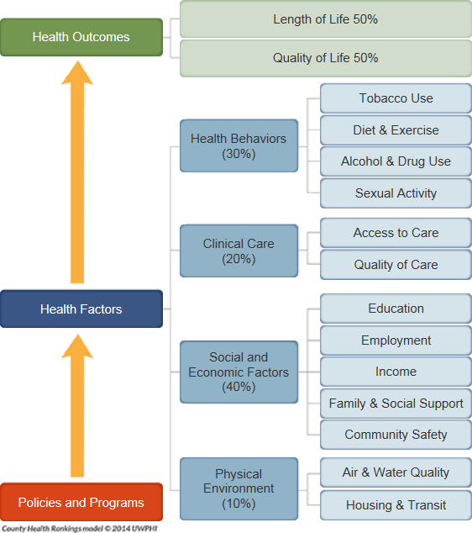
County health rankings
The County Health Rankings are based on a model of community health that emphasizes the many factors that influence how long and how well we live.
The Rankings use more than 30 measures that help communities understand how healthy their residents are today (health outcomes) and what will impact their health in the future (health factors).
Source: County Health Rankings, University of Wisconsin Population Health Institute

Slide 17
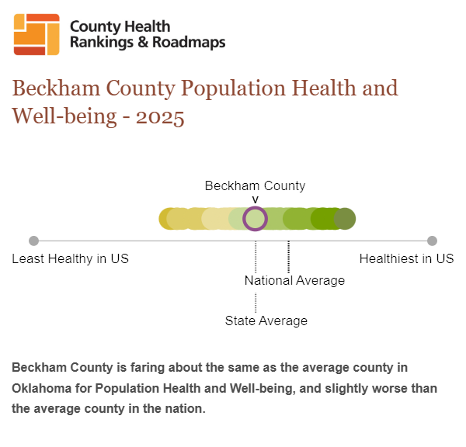
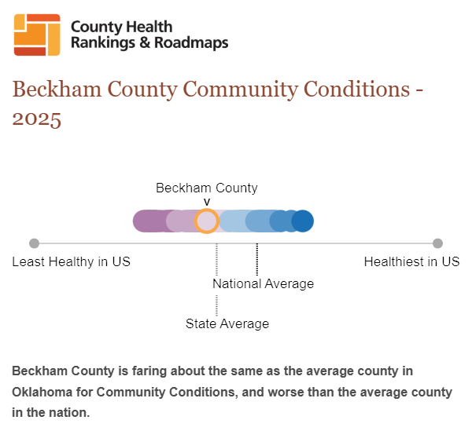
County health rankings
Beckham County is fairing about the same as the average county in Oklahoma for Population Health and Well-being (Health Factors) and slightly worse than the average county in the nation.
Beckham County is fairing about the same as the average county in Oklahoma for Community Conditions (Health Factors) and worse than the average county in the nation.
Source: County Health Rankings, University of Wisconsin Population Health Institute

Slide 18
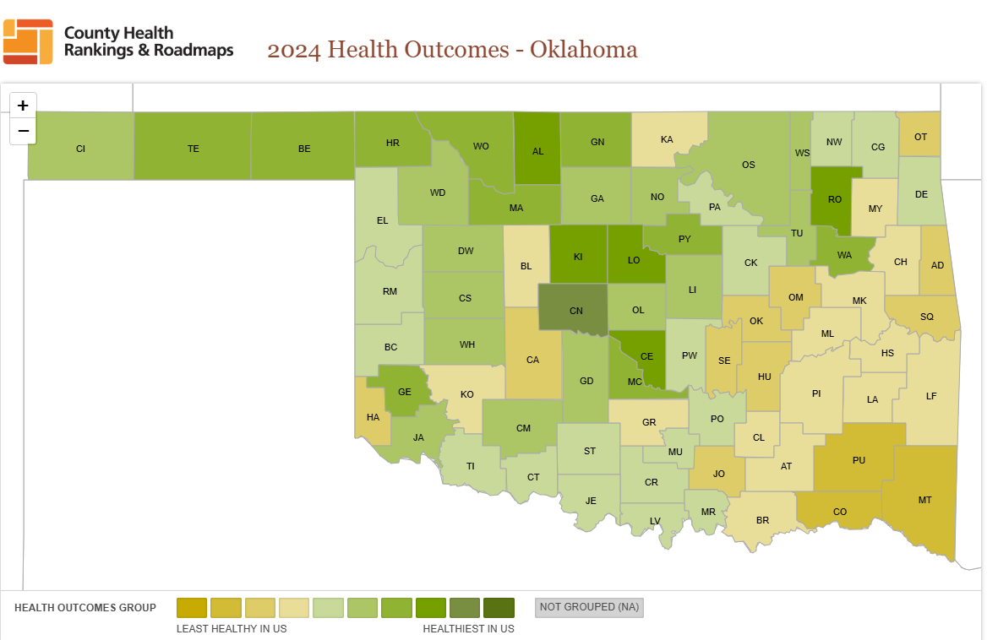
County health rankings – health outcomes
This heat map shows county health rankings for health outcomes in 2024 (the lower the better).
Health outcomes tell us how long people live on average within a community, and how much physical and mental health people experience in a community where they live.
Beckham County ranks 40th out of the 77 counties in Oklahoma for Health Outcomes.
Source: County Health Rankings, University of Wisconsin Population Health Institute

Slide 19
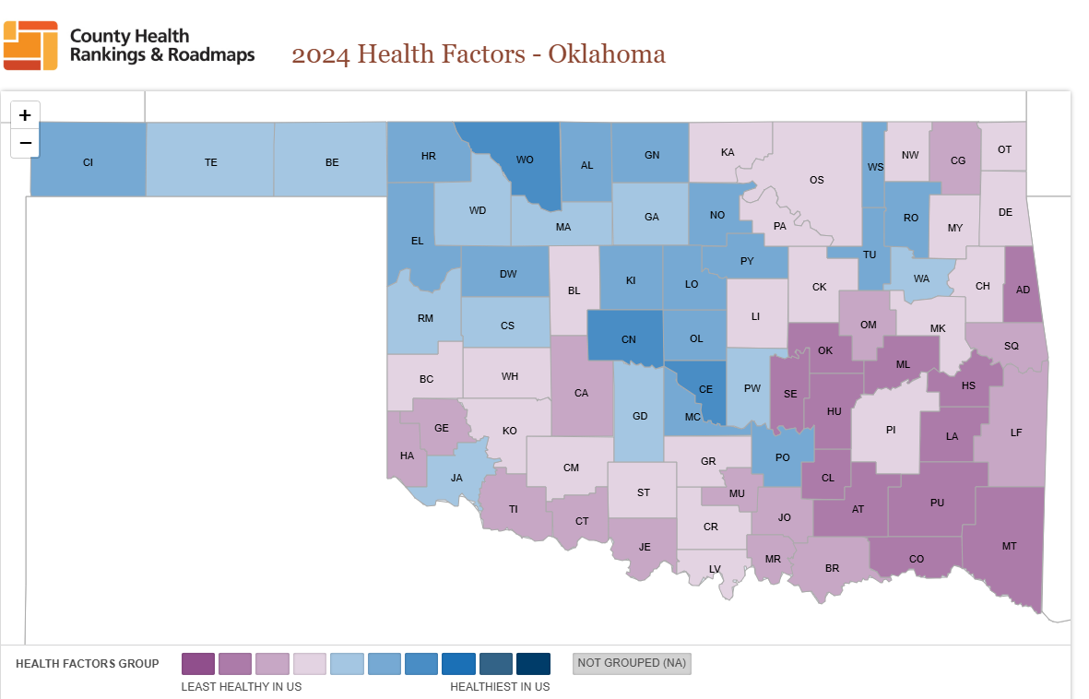
County health rankings – health factors
This heat map shows county health rankings for health factors in 2024 (the lower the better).
Health factors represent the things that influence how well and how long we live. These are things that we can improve to live a longer and healthier lives, and indicators of the future health of a community.
Beckham County ranks 32nd out of the 77 counties in Oklahoma for Health Factors.
Source: County Health Rankings, University of Wisconsin Population Health Institute

Slide 20
County health rankings
Health Indicators and Outcomes for Beckham County
Health Factors
Category (Rank) | Beckham County | Error Margin | Oklahoma | United States
Health Behaviors
Adult Smoking | 21% | 17-25% | 18% | 15%
Adult Obesity | 43% | 35-52% | 40% | 34%
Food Environment Index | 7.0 |  | 5.6 | 7.7
Physical Inactivity | 32% | 27-37% | 27% | 23%
Access to Exercise Opportunities | 80% |  | 71% | 84%
Excessive Drinking | 14% | 11-18% | 14% | 18%
Alcohol-Impaired Driving Deaths | 22% | 12-33% | 27% | 26%
Sexually Transmitted Infections | 399.2 |  | 520 | 496
Teen Births | 36 | 31-42 | 27 | 17
Clinical Care
Uninsured | 19% | 16-21% | 17% | 10%
Primary Care Physicians | 2,000:1 |  | 1,690:1 | 1,330:1
Dentists | 2,000:1 |  | 1,560:1 | 1,360:1
Mental Health Providers | 310:1 |  | 230:1 | 320:1
Preventable Hospital Stays | 2,387 |  | 3,069 | 2,681
Mammography Screening | 34% |  | 40% | 43%
Flu Vaccinations | 37% |  | 42% | 46%
Social & Economic Factors
High School Graduation | 85% | 83-87% | 89% | 89%
Some College | 44% | 36-52% | 60% | 68%
Unemployment | 2.6% |  | 3.0% | 3.7%
Children in Poverty | 24% | 16-32% | 20% | 16%
Income Inequality | 5.2 | 3.4-7.0 | 4.6 | 4.9
Children in Single-Parent Household | 24% | 14-33% | 26% | 25%
Social Associations | 15.9 |  | 11.3 | 9.1
Injury Deaths | 120 | 100-141 | 98 | 80
Physical Environment
Air-Pollution- Particulate Matter | 7.5 |  | 8.7 | 7.4
Drinking Water Violations | No
Severe Housing Problems | 12% | 8-15% | 13% | 17%
Driving Alone to Work | 76% | 71-81% | 80% | 72%
Long Commute- Driving Alone | 17% | 10-24% | 28% | 36%
The table to the left details the specific metrics and measures used by the County Health Rankings to determine the overall Health Outcomes and Health Factors rankings by county.
Beckham County is performing statistically better (green rows) than the state of Oklahoma and the country for:
Excessive Drinking
Preventable Hospital Stays
Unemployment
Beckham County is performing statistically worse (yellow rows) than the state of Oklahoma and country for:
Adult Smoking
Adult Obesity
Physical Inactivity
Teen Births
Uninsured
Mammography Screening
High School Graduation
Some College
Injury Deaths
Source: County Health Rankings, University of Wisconsin Population Health Institute

Slide 21
1x1 community interviews
Great Plains Regional Medical Center held 6 1x1 interviews with community stakeholders to facilitate discussions and get input around the health needs and resources in the community. These were held in April 2025. The invitees were selected from a broad range of individuals in the community including populations from medically underserved and low-income communities.
Communities represented are as follows, noting that individuals may represent multiple community groups:
Beckham County Health Department | Oklahoma State Senator
Great Plains Regional Medical Center Foundation Board Member | Western Technology Center
Business Owner | Retired Community Member
Former Healthcare Provider | Hospital Volunteer
Western Oklahoma Family Care Center | Community Member

Slide 22
1x1 community interviews
The 1x1 community interviews utilized the same 6 questions to ensure consistent data collection.
What do you like best about living in this community?
What are your biggest concerns living in the community?
What are the most serious health issues facing this community?
What issues are facing the medically underserved/low-income community?
What is your vision for a health community?
What are the most beneficial health resources or services in the community?
The following slides highlight the themes across the individual question responses, identifying both strengths and opportunities within the community. The themes were developed by categorizing the question responses into common groupings for analysis and comparison.

Slide 23
1x1 community interviews
What do you like best about living in this community?
What are your biggest concerns living in the community?
Response | Strengths
Community Support | 5
Community Resources | 3
Crime Rate | 2
Schools/Education | 2
Youth Activities | 2
Infrastructure | 1
Access to Specialty Care | 1
Personalized Healthcare | 1
Economic Diversity | 1
Healthcare Services | 1
EMS | 1
Parks & Recreational Areas | 1
Values | 1
Progressive | 1
Cost of Living | 1
Access to Local Care | 1
Community Programs | 1
Fire Department | 1
Large City Amenities | 1
Great Place to Raise a Family | 1
Access to Large City | 1
Great Plains Regional Medical Center | 1
Grand Total | 31
Response | Weakness/ Opportunity
Community Resources | 3
Dependence on Oil & Gas | 2
Homelessness | 2
Transportation | 2
Community Programs | 1
Prenatal Services | 1
Infant Mortality | 1
Access to OBGYN Care | 1
Afforable Housing | 1
COVID Economic Impacts | 1
Access to Specialty Care | 1
Access to Primary Care | 1
Physician Recruitment | 1
Substance Abuse | 1
Safe Housing | 1
Underserved Populations | 1
Workforce Shortages | 1
Diabetes | 1
Water Supply | 1
Economic Diversity | 1
Young Professional Retention | 1
Health Education | 1
Access to Healthy Food | 1
Healthcare Staff Retention | 1
Grand Total | 29
“Community Support” was noted as the biggest strength within the community, being mentioned in five of the six interviews.
“Community Resources” was the most frequently identified concern, followed closely by Dependence on Oil & Gas”, “Homelessness”, and Transportation” with two mentions each.

Slide 24
1x1 community interviews
What are the most serious health issues facing this community?
What issues are facing the medically underserved/low-income community?
Response | Weakness/ Opportunity
Access to Physical Exercise | 2
Diabetes | 2
Cancer Rates | 2
Access to Cancer Care | 2
Access to Healthy Food | 2
Vaccination Rates | 2
Substance Abuse | 1
Pediatric Mental Health | 1
Mental Health | 1
Access to Healthcare | 1
Safety Education | 1
Access to Primary Care | 1
Adult Programming | 1
Disaster Planning | 1
Obesity | 1
EMS Services | 1
Poverty Rates | 1
Trust in Healthcare Professionals | 1
Social Services | 1
Women's Health Screenings | 1
Transportation | 1
Healthy Lifestyle | 1
Infant Mortality | 1
Health Education | 1
Accecss to Long Term Care | 1
Health Literacy | 1
Grand Total | 32
Response | Weakness/ Opportunity
Insurance Coverage | 4
Access to Healthcare | 4
Transportation | 3
Afforable Medication | 3
Access to Physical Exercise | 2
Mental Health | 2
Women's Health Screenings | 2
Diabetes | 2
Language/Translation Services | 1
Schools/Education | 1
Obesity | 1
Dental Care | 1
Access to Healthy Food | 1
Vaccination Rates | 1
Afforable Housing | 1
Access to Primary Care | 1
Poverty Rates | 1
Access to Specialty Care | 1
Substance Abuse | 1
Healthy Lifestyle | 1
Chronic Disease | 1
Adult Programming | 1
Food Insecurity | 1
Health Education | 1
Health Literacy | 1
Grand Total | 39
“Insurance Coverage” and “Access to Healthcare” tied for the most frequently mentioned needs for the medically underserved/low-income community, each accounting for over 10% of responses.
Multiple health issues were identified, those with two of more responses center on chronic disease prevention and basic-health promotion signaling a need within the community.

Slide 25
1x1 community interviews
What is your vision for a health community?
What are the most beneficial health resources or services in the community?
Response | Opportunity
Access to Specialty Care | 2
Physician Recruitment | 2
Competitive Wages | 2
Access to Primary Care | 1
Quality Healthcare | 1
Access to Physical Exercise | 1
Access to Local Care | 1
Schools/Education | 1
Afforable Housing | 1
Health Education | 1
Afforable Medication | 1
Preventive Care | 1
Community Support | 1
Safe Housing | 1
Transportation | 1
Substance Abuse | 1
Community Programs | 1
Fully Staffed Healthcare Facilities | 1
Access to Healthcare | 1
Employee Satisfaction | 1
Grand Total | 23
Response | Strength | Weakness/ Opportunity | Count
Great Plains Regional Medical Center | 4 |  | 4
DHS | 3 |  | 3
Food Pantry | 3 |  | 3
Curches | 2 |  | 2
Access to Primary Care | 1 | 1 | 2
Access to Long Term Care | 2 |  | 2
Resource Awareness |  | 1 | 1
Community Resources | 1 |  | 1
Youth Activities | 1 |  | 1
Community Collaboration | 1 |  | 1
Red Rock Mental Health | 1 |  | 1
Community Health Workers | 1 |  | 1
Westen Oklahoma Family Care Center | 1 |  | 1
Urgent Care | 1 |  | 1
Cost of Living |  | 1 | 1
Shortgrass Community Health Center | 1 |  | 1
Radio & TV for Information Sharing | 1 |  | 1
Clothing Closets | 1 |  | 1
Heart to Heart Pregnancy Clinic | 1
Annual Health Fair | 1 |  | 1
Grand Total | 27 | 3 | 30
“Access to Specialty Care”, “Physician Recruitment”, and “Competitive Wages” each received two responses, indicating barriers to seeking specialty care as well as workforce related challenges.
“Great Plains Regional Medical Center” was noted at the most beneficial health resource within the community, highlighting the value the hospital has on residents and patients.

Slide 26
1x1 community interviews summary
Response | Weakness/ Opportunity
Transportation | 7
Access to Physical Exercise | 5
Diabetes | 5
Access to Healthcare | 5
Access to Primary Care | 5
Insurance Coverage | 4
Access to Specialty Care | 4
Health Education | 4
Substance Abuse | 4
Access to Healthy Food | 4
Afforable Medication | 4
Vaccination Rates | 3
Physician Recruitment | 3
Mental Health | 3
Community Resources | 3
Women's Health Screenings | 3
Afforable Housing | 2
Community Programs | 2
Access to Cancer Care | 2
Healthy Lifestyle | 2
Obesity | 2
Homelessness | 2
Poverty Rates | 2
Infant Mortality | 2
Cancer Rates | 2
Adult Programming | 2
Competitive Wages | 2
Dependence on Oil & Gas | 2
Health Literacy | 2
All Other | 29
Over the six questions in the 1x1interviews, there were 58 areas of opportunity identified over the interviews. The table to the left represents the areas of opportunity that had more than one response.
“Transportation” was the highest reported opportunity, accounting for 7 of the total responses, signaling a high need in the community, although it was not identified as the highest need in any question.
“Access to Physical Exercise”, “Diabetes”, “Access to Healthcare”, and “Access to Primary Care” were each identified 5 times, signaling barriers related to access healthcare and chronic disease management and healthy lifestyles within the community.

Slide 27
Community health survey
Great Plains Regional Medical Center also conducted a 2025 Community Health Needs Assessment Community Survey, that was publicly available from March – April of 2025. It was available on Great Plains Regional Medical Center’s website, social media platforms, and posted in registration and high-volume traffic areas. The survey was available in locations designed to specifically solicit feedback from medically underserved and low-income community members.
The survey was completed by 48 individuals and covered a variety of public health topics.
The subsequent slides detail the identified health needs and areas of concern from the survey.
27

Slide 28
Community health survey
What prevents you, if anything, from receiving healthcare services? (check all that apply).
Answer Choices | % of Responses | Count
Negative experience in the past in our community/at the facility you were seeking care | 55% | 16
Lack of availability of doctors / services | 38% | 11
Insured but unable to pay for care/copays/deductibles | 38% | 11
Insured but the service I need is not covered by my insurance | 31% | 9
Lack of diverse providers who I feel comfortable seeing | 28% | 8
Negative experience with a healthcare provider in another area | 14% | 4
Other (please specify) | 14% | 4
Fear (e.g. not ready to face / discuss health issue) | 10% | 3
Transportation (cost, lack of, not convenient or conducive to appointment availability, etc.) | 10% | 3
Me/my family don’t typically seek out healthcare services | 7% | 2
Don’t know how to find healthcare providers | 7% | 2
Language barriers | 3% | 1
No insurance | 3% | 1
Cultural / religious beliefs | 3% | 1
Unsure which healthcare decisions are right for me/my family | 0% | 0
Don’t understand the need to see healthcare providers | 0% | 0
Answered |  | 29
“Negative experience in the past in our community/at the facility you were seeking care” was the highest cited reason in the community for preventing healthcare services, indicating a need for higher patient experience and satisfaction investments.
“Lack of availability of doctors/services” and “Insured but unable to pay for care/copays/deductibles” were the second highest responses, that signal access and cost barriers to receiving care.

Slide 29
Community health survey
How do you view the following health care topics in your community?
Response | Needs Improvement | Average | Above Average | I don't know | Weighted Average
Access to specialty services | 33 | 9 | 5 | 0 | 2.60
Access to mental health services | 33 | 10 | 1 | 3 | 2.55
Number of physicians/providers | 25 | 19 | 4 | 0 | 2.44
Quality of hospital/clinic care | 24 | 17 | 7 | 0 | 2.35
Access to substance abuse treatment | 30 | 6 | 0 | 10 | 2.22
Access to dental services | 18 | 20 | 8 | 1 | 2.17
Access to Primary Care services | 13 | 29 | 6 | 0 | 2.15
Access to emergency care services | 17 | 17 | 12 | 0 | 2.11
Quality of physician/provider care | 14 | 24 | 10 | 0 | 2.08
Hours the physicians/provider offices are open | 6 | 36 | 5 | 0 | 2.02
Access to long term care | 15 | 20 | 5 | 6 | 1.96
Access to telehealth services | 16 | 19 | 2 | 9 | 1.91
Closeness/convenience of services | 12 | 19 | 15 | 1 | 1.89
Access to optometry services | 6 | 26 | 12 | 1 | 1.82
Access to urgent care services | 6 | 25 | 15 | 0 | 1.80
Answered |  |  |  |  | 48
“Access to specialty services” was the top ranked concern in the community followed closely by “Access to mental health services”. This indicates barriers to access as well as the availability of providers as priority issues within the service area.

Slide 30
Community health survey
How do you view the following health topics in your community?
Response | Not a Concern at all | Minor Concern | Crisis Level of Concern | I don't know | Weighted Average
Obesity | 2 | 13 | 27 | 2 | 2.48
Healthcare workforce shortage | 3 | 12 | 26 | 2 | 2.44
Number of specialty care providers | 4 | 14 | 24 | 1 | 2.42
Mental / behavioral health | 0 | 10 | 28 | 6 | 2.36
Number of mental health providers | 0 | 13 | 26 | 5 | 2.36
Illegal drug use | 2 | 9 | 27 | 6 | 2.30
Chronic disease | 1 | 18 | 20 | 4 | 2.26
Uninsured / insurance rates | 1 | 9 | 25 | 8 | 2.19
Access to nutritious food/Food environment | 5 | 17 | 18 | 3 | 2.16
Diabetes | 3 | 16 | 19 | 5 | 2.14
Alcohol use | 5 | 20 | 15 | 4 | 2.05
Marijuana use | 7 | 15 | 17 | 5 | 2.00
Physical Inactivity | 7 | 22 | 12 | 3 | 1.98
Smoking / tobacco / vaping | 9 | 13 | 17 | 5 | 1.95
Women's health | 4 | 22 | 12 | 5 | 1.95
Children in poverty | 1 | 16 | 17 | 9 | 1.95
Response | Not a Concern at all | Minor Concern | Crisis Level of Concern | I don't know | Weighted Average
Number of primary care providers | 12 | 20 | 11 | 1 | 1.93
Poverty rates | 1 | 19 | 15 | 9 | 1.91
Homelessness / housing instability | 4 | 19 | 14 | 7 | 1.91
Bullying | 4 | 17 | 15 | 8 | 1.89
Care / programs for older adults | 2 | 19 | 14 | 9 | 1.86
Availability of preventive care / health education / health literacy | 2 | 23 | 11 | 8 | 1.84
Dental care | 11 | 18 | 9 | 5 | 1.72
Access to Exercise Opportunities | 13 | 19 | 8 | 4 | 1.70
Income inequality | 8 | 15 | 12 | 9 | 1.68
Domestic violence / abuse | 2 | 21 | 10 | 11 | 1.68
Violent crime | 8 | 23 | 5 | 7 | 1.60
Teen births | 3 | 23 | 7 | 11 | 1.59
Vaccination rates | 8 | 18 | 7 | 10 | 1.51
Education rates | 6 | 19 | 6 | 12 | 1.44
Unemployment | 6 | 18 | 7 | 13 | 1.43
Social associations/programming | 5 | 18 | 6 | 15 | 1.34
Pollution / water quality | 13 | 20 | 0 | 10 | 1.23
Answered |  |  |  |  | 44
“Obesity” was the health topic that generated the most concern within the community, which can be an indicator of the need for chronic disease management, health education, and preventive care.
“Healthcare workforce shortage” and “Number of specialty care providers” had the second and third highest concern rankings, respectively. This signals healthcare staffing, recruitment, and retention concerns within the community.

Slide 31
Community health survey
In your opinion, what social determinants of health are unaddressed or inadequately addressed in our community? (Check all that apply.)
What additional healthcare services would you like to see in our community? (Free Text)
Response | Count
OBGYN | 6
Surgeons | 6
Mental Health Care | 3
Dermatology | 3
Pediatricians | 3
Dental Care | 2
Primary Care Physicians | 2
Access to Local Care | 1
Cancer Care | 1
Optometrist | 1
Emergency Services | 1
Nephrology | 1
Functional Medicine | 1
Oncology | 1
Podiatry | 1
Orthopedic Surgeons | 1
Access to Physician Exercise | 1
Dietitian | 1
Ambulance Services | 1
Prosthodontist | 1
Women's Health | 1
Health Education | 1
Access to Healthy Foods | 1
Internal Medicine | 1
Grand Total | 42
Response | % of Responses | Count
Job & income opportunities | 67% | 22
Safe housing & neighborhoods | 39% | 13
Physical activity opportunities | 39% | 13
Food insecurity | 36% | 12
Transportation | 33% | 11
Racism and/or discrimination | 27% | 9
Language and literacy skills | 27% | 9
Education | 24% | 8
Polluted air and water | 6% | 2
Other (please specify) | 6% | 2
Answered |  | 33
“Job and income opportunities” was the highest ranked unaddressed or inadequately address social determinant of health within the community, signaling that economic stability is one of the most pressing concerns.
“Safe housing & neighborhoods” and “Physical activity opportunities” were the second highest ranked, reflect need for environmental and social investment within the community.
“OBGYN” and “Surgeons” were the most frequently requested additional healthcare services in the community, each being identified six times.

Slide 32
Community health survey summary
Health Need/Priority | Rank
Negative experience in the past in our community/at the facility you were seeking care | 1
Access to specialty services | 1
Obesity | 1
Job & income opportunities | 1
OBGYN | 1
Surgeons | 1
Lack of availability of doctors / services | 2
Insured but unable to pay for care/copays/deductibles | 2
Access to mental health services | 2
Healthcare workforce shortage | 2
Safe housing & neighborhoods | 2
Physical activity opportunities | 2
Mental Health Care | 2
Dermatology | 2
Pediatricians | 2
Insured but the service I need is not covered by my insurance | 3
Number of physicians/providers | 3
Number of specialty care providers | 3
Food insecurity | 3
Dental Care | 3
Primary Care Physicians | 3
Lack of diverse providers who I feel comfortable seeing | 4
Quality of hospital/clinic care | 4
Mental / behavioral health | 4
Number of mental health providers | 4
Transportation | 4
Negative experience with a healthcare provider in another area | 5
Access to substance abuse treatment | 5
Illegal drug use | 5
Racism and/or discrimination | 5
Language and literacy skills | 5
The table to the left highlights the top areas of need across multiple questions in the community survey. Since respondents could select multiple answers, the top five highest-ranked responses from each question are displayed, with a ranking of 1 indicating the highest need or priority in the community.
There were six health needs/priorities that were ranked the highest need across the survey questions
Patient Satisfaction as well as access and provider availability, as reflected in “Negative experience in the past...”, “Access to specialty services”, “OBGYN”, and “Surgeons” responses, are highlighted as priority areas of need within the community.
Foundational health and well-being challenges were also priority needs, identified through responses of “Obesity” and “Job & income opportunities”.

Slide 33
Data triangulation process
To identify areas of overlap and common themes between the three data sources: Public Health Data, 1x1 Interviews, and Community Health Survey responses, a crosswalk analysis was performed.
This crosswalk was necessary because the areas of opportunity, survey results, and focus group responses did not align on a one-to-one basis.
For instance, similar responses such as “Mammography Screening" and “Women’s Health Screenings" were grouped into a single category of “Women’s Health Screenings” to facilitate data triangulation. Another example is “Mental Health”, “Mental Health Care”, and “Mental / behavioral health” were grouped into “Mental Health”.
The following slides display the overlapping themes across the top five areas of opportunity within the three data sources. If there were opportunities that tied in their ranking value, all equivalent ranked opportunities were included.

Slide 34
Service area assessment
Public Health Data Opportunities
High School Rates
Teen Births
College Rates
Adult Smoking
Injury Deaths
Community Survey High Ranking Priorities
1x1 Interviews High Need Areas
Women’s Health Screenings
Community Programs
Physical Activity
Patient Satisfaction
Health Education
Obesity
Insurance Coverage
Language/ Translation Services
Food Insecurity
Dependence on Oil & Gas
Cancer Rates
Diabetes
Mental Health
Substance Abuse
Affordable Housing
Physician Availability
Discrimination
Surgeons
Physician Recruitment
Adult Programming
Healthy Food
Quality of Care
Specialty Care
Transportation
Affordable Healthcare
Healthcare Workforce Shortages
Healthcare Access
Dental Care
Affordable Medications
Primary Care
Job & Income Opportunities
Vaccination Rates
Homelessness
Infant Mortality
Diverse Providers
OBGYN
Dental Care
Community Resources
Healthy Lifestyles
Pediatrics
Cancer Care
Dermatology

Slide 35
Community resources
Sure, I can help with that! Here is the list transformed into a table:
Let me know if you need any further assistance!
Access to health care facilities, providers, and other resources are essential to community health and reflects the strength of the local community. The table below details the health and social resources available within the community to assist in addressing needs identified:
Great Plains Regional Medical Center | Department of Human Services | Food Pantries
Red Rock Mental Health | Western Oklahoma Family Care Centers | Community Health Workers
Urgent Care | Shortgrass Community Health Center | Heart to Heart Pregnancy Clinic
Annual Health Fair | Clothing Closets | Churches
Assisted Living & Nursing Homes | Physician Office & Clinics | Dental Offices
Chiropractic Offices | EMS | Dialysis Provider
Air Transport Provider | Counseling Providers | Pharmacies

Slide 36
Prioritization of needs
The core CHNA work group was comprised of the following staff:
CEO
CFO/VP of Finance
COO
This group met to review the needs identified through the community health needs assessment process. After analyzing input from the focus groups, survey, and community health data, they did a preliminary prioritization that identified needs based on potential impact on community health, the urgency of the need, and the ability to meet these needs. The following health areas are determined to be prioritized, in no particular order:
Prioritized items:
Recruitment of specialties (OBGYN, General Surgery)
Women's Health Screenings
Increase Patient Satisfaction
Focus on Quality of Care
Reinstate and grow Cancer Care
Some identified health needs beyond the scope and/or abilities of Great Plains Regional Medical Center are not prioritized at this time. More detail can be seen in our implementation plan.

Slide 37
Evaluation of prior chna
Great Plains Regional Medical Center completed a Community Health Needs Assessment in 2022. No written comments have been received from this assessment. Great Plains Regional Medical Center prioritized the following needs during this assessment and have conducted the following activities to address the needs identified:
Overarching increased access to care/services in the area of mental health- GPRMC joined with local public education in developing behavioral health initiatives and assessments for local school age children. The project was called Project AWARE.
Overarching increased access to care/services in the area of OB/GYN care- GPRMC has focused on recruitment of OBGYN specialties with 1 set to start in 2025

Slide 38
Next steps
This Community Health Needs Assessment report was approved by the Great Plains Regional Medical Center Board of Directors at the meeting on June 24th, 2025.
Great Plains Regional Medical Center is required to adopt an organization-specific implementation strategy in response to the Community Health Needs Assessment report. This will be developed and approved by the board no later than November 15th, 2025.
The implementation strategy will be reviewed on an annual (or more frequent) basis. The CHNA process, public report, and implementation strategy will be repeated every three years, as required by Internal Revenue Code 501(r)(3).

Slide 39
Contact information
Community members who would like to provide comments on the needs identified or provide input on the next CHNA process are encouraged to contact Great Plains Regional Medical Center with their inquiries, suggestions or comments.
Misty Carter
Chief Operating Officer
Great Plains Regional Medical Center
1801 W 3rd St, Elk City, OK, 73644
mcarter@gprmc-ok.com

